Slide 1
Mathematical Reasoning
We need mathematical reasoning to
determine whether a mathematical argument is
correct or incorrect and
construct mathematical arguments.
Mathematical reasoning is not only important for conducting proofs and program verification, but also for artificial intelligence systems (drawing inferences).

Slide 2
Validity Using Truth Tables
Let A and B be two statement formulas.
We say that “ B logically follows from A” or “ B is a valid conclusion of the premise A” iff A → B is a tautology, that is A ⇒ B.
From a set of premises {H₁ , H₂ , …. , H_{n} } a conclusion C follows logically iff H₁ ∧ H₂ ∧ …. ∧ H_{n} ⇒ C ---------- (1)
Given a set of premises and a conclusion, it is possible to determine whether the conclusion logically follows from the given premises by constructing truth tables
“Truth table technique” for the determination of the validity of a conclusion

Slide 3
Validity Using Truth Tables
Determine whether the conclusion C follows logically from the premises H₁ and H₂ .
H₁ : P → Q H₂: P C: Q
H₁ : P → Q H₂: ~P C: Q
H₁: P → Q H₂: ~ (P ∧ Q) C: ~P
H₁ : ~P H₂:P ↔ Q C:~ (P ∧ Q)
H₁ : P → Q H₂:Q C: P

Slide 4
Rules of Inference
Rule P: A premise may be introduced at any point in the derivation
Rule T: A formula S may be introduced in a derivation if S is tautologically implied by any one or more of the preceding formulas in the derivation

Slide 5
Rules of Inference
Rules of inference provide the justification of the steps used in a proof.
One important rule is called modus ponens or the law of detachment. It is based on the tautology
(p∧(p→q)) → q. We write it in the following way:
p
p → q
____
∴ q
The two hypotheses p and p → q are
written in a column, and the conclusion
below a bar, where ∴ means “therefore”.

Slide 6
It is valid inference because [p ∧ (p → q)] → q is a tautology.
p | q | p → q | p ∧ p → q | [p ∧ p → q]→ q
T | T | T | T | T
T | F | F | F | T
F | T | T | F | T
F | F | T | F | T

Slide 7
The difference between implication and inference is the truth of either p or q. But the truth of both p and p→q does guarantee the truth of q.
In place of propositions p and q in rule of detachment we can substitute propositional functions of any degree of complexity.
Ex: p ∧ (q ∨ ~r)
[p ∧ (q ∨ ~r)]→ s ∧ [(~t) ∨ u]
-----------------------------
∴ s ∧ (~t) ∨ u

Slide 8
Rules of Inference
The general form of a rule of inference is:
p₁
p₂
.
.
.
p_{n}
____
∴ q
The rule states that if p₁ and p₂ and … and p_{n} are all true, then q is true as well.
These rules of inference can be used in any mathematical argument and do not
require any proof.

Slide 9
Rules of inference related to the language of propositions:
Rules of Tautological Name
inference form
1. p p→p∨q Addition
-----
∴p∨q
2. p∧q (p∧q)→p Simplification
-----
∴p
3. p
p→q [p∧(p→p)]→q Modus ponens/
------ Rule of detachment
∴q

Slide 10
4. ~q
p→q [~q∧( p→q)]→~p modus tollens
------
∴~p
5. p∨q
~p [(p∨q)∧(~p)]→q disjunctive
----- syllogism
∴q
6. p→q
q→r [(p→q)∧(q→r)]→[p→r] Hypothetical
----- syllogism /
∴p→r Transitive rule

Slide 11
7. p
q conjunction
-----
∴p∧q
8. (p→q)∧(r→s) [(p→q)∧(r→s)∧(p∨r)]→[q∨s]
p∨r Constructive dilemma
----
∴q∨s
9. (p→q)∧(r→s) [(p→q)∧(r→s)∧(~q∨~s)]→[~p∨~r]
~q ∨~s Destructive dilemma
--------
∴~p∨~r
Fundamental Rule 3: DeMorgan’s laws
~(p∨q)≡~p∧~q
~(p∧q)≡~p∨~q
Fundamental Rule 4: Law of Contrapositive
p→q≡~q→~p

Slide 12
Arguments
Just like a rule of inference, an argument consists of one or more hypotheses and a conclusion.
We say that an argument is valid, if whenever all its hypotheses are true, its conclusion is also true.
However, if any hypothesis is false, even a valid argument can lead to an incorrect conclusion.

Slide 13
Arguments
example:
“If it rains today, then we will not have a barbeque today.
If we do not have a barbeque today, then we will have a barbeque tomorrow.
Therefore, if it rains today, then we will have a barbeque tomorrow.”
This is a valid argument: If its hypotheses are true, then its conclusion is also true.

Slide 14
Arguments
Let us formalize the previous argument:
p: “It is raining today.”
q: “We will not have a barbecue today.”
r: “We will have a barbecue tomorrow.”
So the argument is of the following form:
p→q
q→r
_____
∴ p→r
Hypothetical syllogism

Slide 15
Arguments
Another example:
Gary is either intelligent or a good actor.
If Gary is intelligent, then he can count
from 1 to 10.
Gary can only count from 1 to 2.
Therefore, Gary is a good actor.
i: “Gary is intelligent.”
a: “Gary is a good actor.”
c: “Gary can count from 1 to 10.”

Slide 16
Arguments
i: “Gary is intelligent.”
a: “Gary is a good actor.”
c: “Gary can count from 1 to 10.”
Step 1: ¬c Hypothesis
Step 2: i → c Hypothesis
Step 3: ¬i Modus tollens Steps 1 & 2
Step 4: a ∨ i Hypothesis
Step 5: a Disjunctive Syllogism
Steps 3 & 4
Conclusion: a (“Gary is a good actor.”)

Slide 17
Example:
If I study,I will not fail in the examination.
If I donot watch TV in the evenings,I will study
I failed in the examination.
Therefore,I must have watched TV in the Evening.

Slide 18

Example:Verify whether the following argumnts are valid or not:
1)P->Q, R->S, PvR => QvS
2)P->Q, R->S, ~Qv~S => ~(P^R)
3)P->Q, Q->R, P =>R
4) ~Q, P->Q =>~P
5)S.T SvR IS TAUTOLOGICALLY IMPLIED BY (PvQ)^(P->R)^(Q->S)
6) S.T R^(PvQ) is valid conclusion from the premises PvQ, Q->R, P->M and ~M.
7)P->Q,Q->~R, R, Pv(J^S) => J^S
8) ~J->(MvN),(HvG)->~J, HvG =>MvN

Slide 19
Rule CP: Rule of Conditional Proof.
If we can derive S from R and a set of premises, then we can derive R-> S from the set of premises alone.
If the conclusion is of the form R-> S, then R is taken as an additional premise and S is derived from the given premises and R
Show that R-> S can be derived from the premises P-> (Q-> S), ~RvP, and Q.

Slide 20
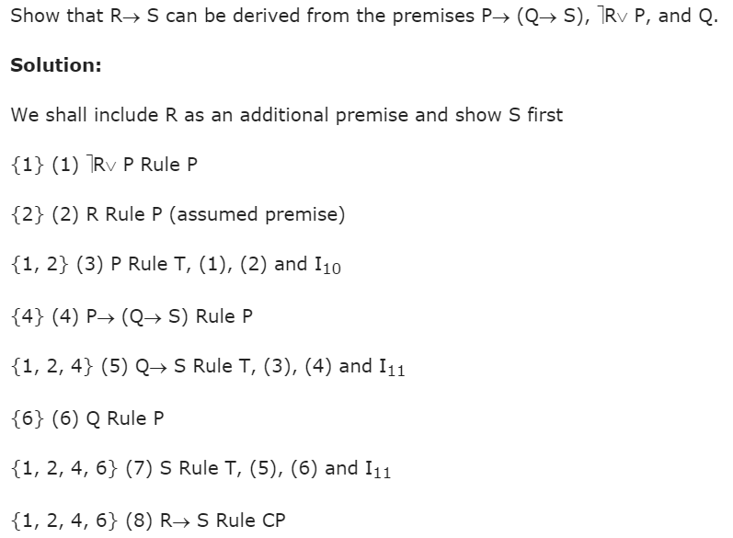

Slide 21
Consistency of Premises and Indirect Method of Proof.
A set of formulas H₁,H₂,…,H_{m} is said to be consistent if their conjunction has the truth value T for some assignment of the truth values to the atomic variables appearing in H₁,H₂,…,H_{m}.
If, for every assignment of the truth values to the atomic variables, atleast one of the formulas H₁,H₂,…,H_{m} is false, so that their conjunction is identically false, then the formulas H₁,H₂,…,H_{m} are called inconsistent.

Slide 22
A set of formulas H₁, H₂,…,H_{m} are inconsistent if their conjunction implies a contradiction.
That is, H_{1,} H₂ … H_{m} => R ^ ~R
where R is any formula. R ^~R is a contradiction.
In order to show that a conclusion C follows logically from the premises
H₁, H₂, … , H_{m} we assume that C is false and consider ~ C as an additional premises.

Slide 23
Show the following premises are inconsistent
If Jack misses many classes through illness, then he fails high school.
If Jack fails high school, then he is uneducated.
If Jack reads a lot of books, then he is not uneducated.
Jack misses many classes through illness and reads a lot of books.

Slide 24
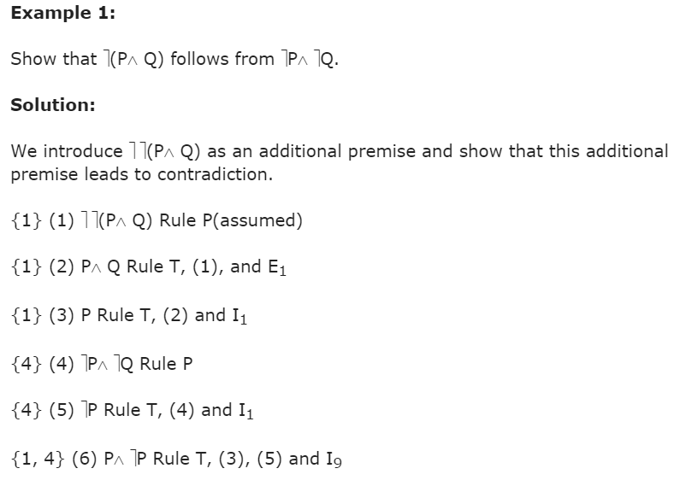

Slide 25
